Slide 1
STUDENT PLACEMENT ANALYSIS USING POWER BI

Slide 2
INTRODUCTION :
“This project focuses on student placement analysis using Power BI. It helps identify how
academics, skills, and experience affect placements, and provides insights to improve
placement rates.”

Slide 3
About the Dataset :
The dataset contains student-related information such as:
Academic details – CGPA and backlogs
Skills – coding, aptitude, communication, soft skills
Experience – internships, projects, certifications
Placement status – placed or not placed
Demographic details – gender and branch
This dataset helps in understanding the relationship between student profiles and placement outcomes.

Slide 4
Objective of the Project :
The main objectives of this project are:
To analyze the overall placement performance
To understand the impact of CGPA, backlogs, and academics
To study the role of internships, projects, and certifications
To evaluate the importance of coding, aptitude, and communication skills
To provide recommendations to improve placement rates

Slide 5
What Analysis I Did Using This Data :
Using this dataset, I performed exploratory and business analysis to identify key placement drivers. I analyzed these factors to identify what improves or reduces placement chances.

Slide 6
Understanding the Data :
Before starting the analysis, it is important to understand the dataset and the key features available in it. Understanding the data helps in identifying patterns, business problems, and useful insights.

Slide 7
What the Overall Data Tells :
“The dataset provides complete information about students and their placement outcomes.”
It gives an overall view of:
Total number of students
Number of placed and not placed students
Academic performance of students
Skill levels of students
Internship and project experience
Factors affecting placement success
👉 “This overall data helps in measuring placement performance and identifying areas for improvement.”

Slide 8
Important Features in the Dataset :
1. Academic Features :
CGPA – Indicates student academic performance
Backlogs – Shows pending subjects and affects eligibility
2. Experience Features :
Internships – Practical industry exposure
Projects – Hands-on technical experience
Certifications – Additional skill validation

Slide 9
3. Skill Features :
Coding Skills – Technical ability
Aptitude Score – Problem-solving ability
Communication Skills – Important for interviews
Soft Skills – Teamwork and adaptability
4. Placement Feature :
Placement Status – Placed or Not Placed

Slide 10
Data Preparation in Power BI :
Before analysis, the data was cleaned and transformed using Power BI.
The steps performed were:
I checked for missing or null values, and no null values were found.
I checked for duplicate records, and no duplicates were identified.
I created additional columns such as CGPA category and internship category to segment students into meaningful groups for better analysis.
I created measures like total students, placed students, and placement percentage to track overall placement performance.
These steps helped me prepare clean and structured data for accurate analysis in Power BI.

Slide 11
EDA Process (Exploratory Data Analysis) :
EDA stands for Exploratory Data Analysis. It is the process of understanding the data, finding patterns, checking relationships, and identifying important insights before making final conclusions.
EDA is the process of exploring data to understand trends and patterns.
I Segmented data based on Over View , Performance , Skills & Score

Slide 12
OVER VIEW ANALAYIS

Slide 13
ABOUT OVER VIEW :
This dashboard provides an overall summary of student placement performance and student distribution. It gives a high-level view of total students, placed students, placement percentage, gender distribution, and placement status.
Out of 5000 students, 1812 are placed with a 36.24% placement rate. Gender distribution is balanced, and CGPA plays an important role in placement success.

Slide 14
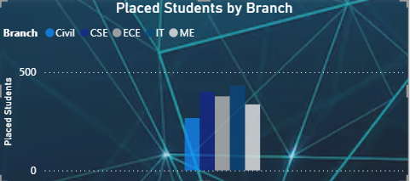
This bar chart shows the number of students placed from each academic branch or department.
Each bar represents the count of placed students in that branch.
This chart is used to compare placement performance across different branches.
IT Shows the highest placed students in the chart.
CSE has one of the highest placement counts.
ECE Placement count is also high, close to CSE.
Civil Has the lowest placed students among all branches.
Mechanical Engineering Moderate placement count, lower than CSE/ECE/IT.

Slide 15
Overall Insights OF CHART:
Technical branches like IT, CSE, and ECE have stronger placement performance.
Core branches like Civil and Mechanical show lower placement counts.
This indicates that current market demand is higher for technology-related skills.

Slide 16
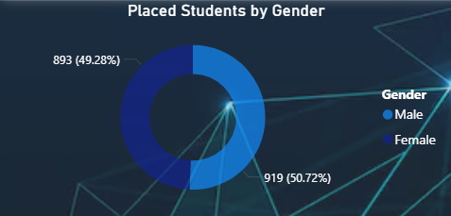
This donut chart shows the distribution of placed students based on gender.
It compares how many male and female students got placed.
This chart is used to compare placement outcomes between male and female students.
Male: 919 students (50.72%)
Female: 893 students (49.28%)

Slide 17
Overall Insights OF CHART :
The difference between male and female placements is only 26 students, which is very small.
Placement distribution is almost equal, showing balanced opportunities.
There is no major gap based on gender in placement outcomes.
Both genders are participating successfully in placements.

Slide 18
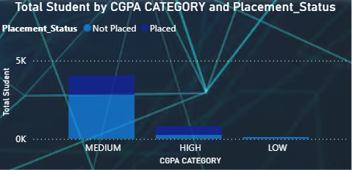
This stacked column chart shows the number of students in each CGPA category and their placement status.
This chart is used to analyze the relationship between academic performance (CGPA) and placements.
This chart compares students by CGPA and placement status. Medium CGPA has the highest number of students and placements(8-10) categories . High CGPA students have better placement success(5-7) categories , while low CGPA students have the lowest placements(below 5 ) categories .

Slide 19
Overall Insights OF CHART :
Higher CGPA generally leads to better placement chances.
Medium CGPA group is the largest population, so improving this segment can significantly raise total placements.
Low CGPA students are at highest risk of not getting placed.

Slide 20
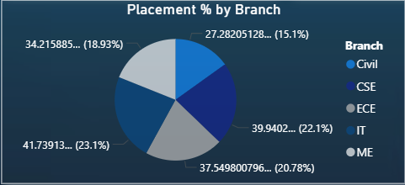
This pie chart shows the placement percentage distribution across different branches.
This chart is used to compare branch-wise placement performance in percentage terms rather than student counts.
IT has the highest placement percentage 41.74%.
CSE is the second-highest performer 39.94%.
ECE performs moderately well 37.55%.
Mechanical Engineering has average placement performance 34.22%.
Civil has the lowest placement percentage 27.28%.

Slide 21
Overall Insights OF CHART :
Technology-related branches (IT, CSE) lead placement performance.
Core branches (Civil, Mechanical) have lower placement percentages.

Slide 22
OVERALL INSIGHTS
Technical branches currently have stronger job mark
The institution provides balanced placement opportunities across gender.
Medium CGPA students are the largest opportunity group for improvement.
Lower placement rates in Civil and ME branches
Need to convert medium CGPA students into higher placement success
Low outcomes for low CGPA students
Overall, IT and CSE perform best, placements are balanced across gender, higher CGPA improves success, and lower-performing branches need targeted support. With training and internships, placements can improve further.”

Slide 23
PERFORMANCE ANALYSIS

Slide 24
ABOUT PERFORMANCE ANALYSIS :
The Performance Analysis dashboard focuses on evaluating the key academic and practical factors that influence student placements.
It helps measure how student performance impacts employability and placement success.

Slide 25
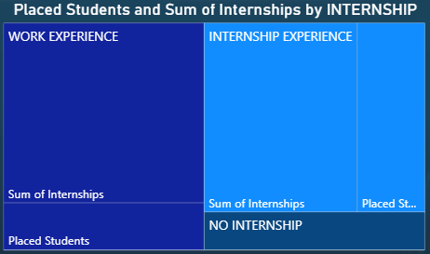
This is a Tree map chart that shows the relationship between internship category and placement outcomes.
A tree map is used to compare categories visually based on size.”
Work Experience (2-3) category Students with prior work experience have the strongest placement outcomes.
Internship Experience(1) category Students who completed internships perform better than students without experience.
No Internship (0) category Students without internship exposure have lower placement outcomes.

Slide 26
Overall Insights OF CHART :
Students with Work Experience perform best.
Students with Internship Experience also show good placement success.
Students with No Internship have the weakest outcomes.
Practical exposure is a major driver of placements.

Slide 27
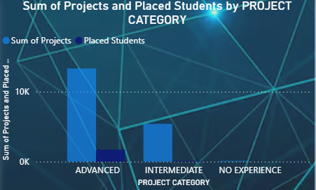
This clustered column chart compares project category with two important metrics.
This chart is used to compare categories side by side.
Advanced Projects ( more than 4 ) category Highest number of projects and highest placed students.
Intermediate Projects (2-3) category Moderate number of projects and fewer placed students than advanced.
No Experience Very category low or nearly zero projects and lowest placed students.

Slide 28
Overall Insights OF CHART :
There is a clear positive relationship between project experience and placement success.
Advanced project students have the best outcomes.
Intermediate students have average outcomes.
No experience students have the weakest outcomes.

Slide 29
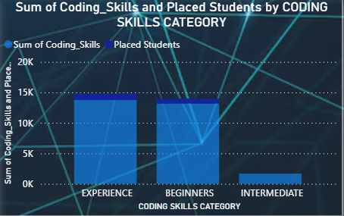
This column chart compares coding skill categories with two metrics.
This chart is used to compare different coding skill groups side by side.
Experience ( 7-10 ) category Highest total coding skill score and highest placed students.
Beginners (4-6) category Slightly lower than experience category.
Intermediate category Lowest total score and lowest placed students.

Slide 30
Overall Insights OF CHART :
Coding skills have a strong positive impact on placements.
Students with experienced coding skills perform best in placements.
Beginner-level students also show good placement potential, but less than experienced students.
Lower skill groups need training intervention.

Slide 31
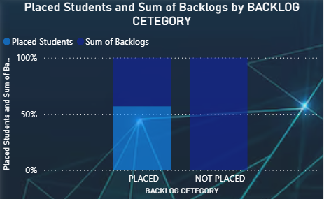
This 100% stacked column chart compares placement status with sum of backlogs.
This chart helps understand how backlog levels relate to placement outcomes.
Placed Category ,This column shows a significant share of placed students, with a lower relative impact of backlogs.
Not Placed Category, This column is dominated by backlog share.

Slide 32
Overall Insights OF CHART :
Backlogs have a negative relationship with placement success.
Students with fewer backlogs show better placement outcomes.
High backlog students are at higher risk of being not placed.
Recruiters may prefer academically consistent candidates.

Slide 33
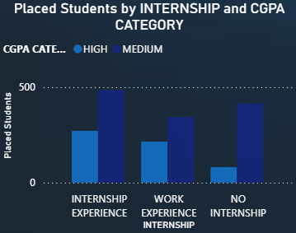
This clustered column chart shows the number of placed students based on two factors.
This chart helps understand how academics and practical experience together affect placements.
This chart is used to compare multiple categories side by side.”
Internship Experience : Medium CGPA has the highest placed students , High CGPA also performs strongly.
Work Experience Internship : Medium CGPA higher than High CGPA, Both categories show solid placements.
No Internship : Medium CGPA still has placements , High CGPA is much lower compared to other categories.

Slide 34
Overall Insights OF CHART :
Internship experience improves placement outcomes for both High and Medium CGPA students.
Medium CGPA students consistently show higher placement counts (likely larger population size).
Students without internships have weaker placement performance.
Practical experience can compensate for average academics.

Slide 35
OVERALL INSIGHTS
Students with work experience and internship experience have better placement outcomes than students with no internship.
Hands-on project work is highly valued by recruiters.
Technical skills are a major driver of placement success.
Academic consistency is important for eligibility and hiring.
Practical experience can significantly boost placement chances, even for medium CGPA students.
The Performance Analysis dashboard proves that placements are not based on marks alone. Students who combine academics with skills, internships, and projects have the highest success.

Slide 36
SKILLS & SCORE ANALYSIS

Slide 37
ABOUT SKILLS & SCORE ANALYSIS :
The Skills & Score Analysis dashboard focuses on evaluating how student skills and test scores influence placement success.
It helps identify whether technical ability, communication, aptitude, and certifications improve employability.
The Skills & Score Analysis dashboard studies coding, aptitude, communication, soft skills, and certifications to understand how student skills affect placements.

Slide 38
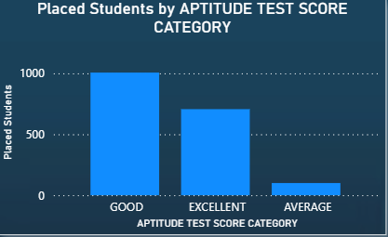
This column chart shows the number of placed students based on their aptitude test score category.
This chart is used to compare placement outcomes across aptitude score levels.
Good category , Highest number of placed students (around 1000).
Excellent category , Second highest placed students (around 700).
Average category , Lowest number of placed students (around 100).

Slide 39
Overall Insights OF CHART :
Students with Good and Excellent aptitude scores dominate placements.
Students in the Good category contribute the largest placement count.
Excellent scorers also perform strongly in placements.
Students with average aptitude scores have significantly lower placement outcomes.

Slide 40
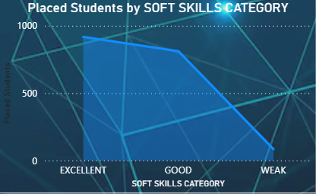
This area/line chart shows the number of placed students based on their soft skills category.
The chart helps analyze how soft skills affect placement outcomes.
This chart is used to show trends and compare placement performance across different soft skill levels.
Excellent ( 6-10 ) category , Highest number of placed students (around 900+).
Good (4-5) category , Slightly lower than Excellent (around 750–800).
Weak , Very low placed students (around 100).

Slide 41
Overall Insights OF CHART :
Placement success increases as soft skill level improves.
Excellent and Good categories dominate placements.
Students with weak soft skills struggle significantly in placements.
Soft skills are almost as important as technical skills.

Slide 42
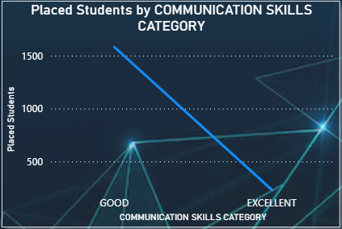
This line chart shows the number of placed students based on their communication skills category.
The chart helps understand how communication skills influence placement success.
A line chart is used to show comparison and trend between categories.
Good Communication Skills ( 8-10 ) category , Highest number of placed students (around 1600).
Excellent Communication Skills ( 5-7) category , Lower number of placed students (around 250).

Slide 43
Overall Insights OF CHART :
Communication skills have a strong impact on placements.
Good communication category dominates placements, likely because more students belong to this group.
Students with strong verbal and interpersonal skills perform better during hiring processes.
Communication ability is important along with technical skills.

Slide 44
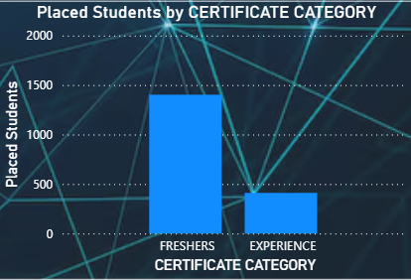
This column chart shows the number of placed students based on their certificate category.
The chart helps analyze how certification category relates to placement outcomes.
This chart is used to compare placement counts between different certificate categories.
Freshers Category ( more than 3 ) , Highest number of placed students (around 1400).
Experience Category ( 1-2) , Lower placed students (around 400).

Slide 45
Overall Insights OF CHART :
Certifications help improve placement readiness for fresh graduates.
Both freshers and experienced students benefit from additional certifications.
Industry-recognized certifications increase employability.
Freshers show higher placements mainly because the dataset likely contains a larger fresher population.

Slide 46
OVERALL INSIGHTS
Strong aptitude skills improve performance in recruitment tests and selection rounds.
Communication, teamwork, confidence, and professionalism are important for employability.
Technical knowledge alone is not enough; communication skills are also critical.
Industry certifications help students stand out during recruitment.
“The Skills & Score Analysis dashboard proves that placements are not based only on academics. Students with strong aptitude, communication, soft skills, and certifications achieve better placement outcomes.”

Slide 47
FINAL INSIGHTS

Slide 48

Placement rate is low, so improvement is needed in training and skills.
Higher CGPA increases placement probability, but skills are also important.
Opportunities are fair, but depend on skills and branch
Students improve coding, aptitude, and communication skills
Focus on skill-based training programs
Encourage internships & certifications
Soft skills alone are not enough Technical + communication skills together improve placement chances
👉 “The dashboard clearly shows that placement success is not based only on marks. Students who combine academics with technical skills, internships, projects, communication ability, and certifications achieve the best placement outcomes.”
👉 “By focusing on skill development and practical exposure, institutions can significantly improve overall placement performance.”

Slide 49
THANK YOU

